Slide 1
Artificial Intelligence: Representation and Problem Solving
Sequential Decision Making (4): Active Reinforcement Learning
15-381 / 681
Instructors: Fei Fang (This Lecture) and Dave Touretzky
feifang@cmu.edu
Wean Hall 4126

Slide 2
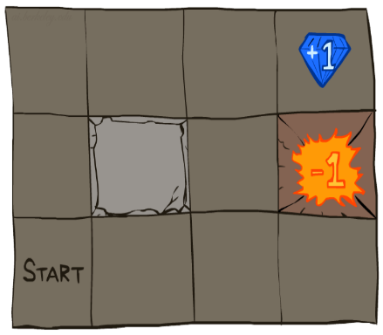

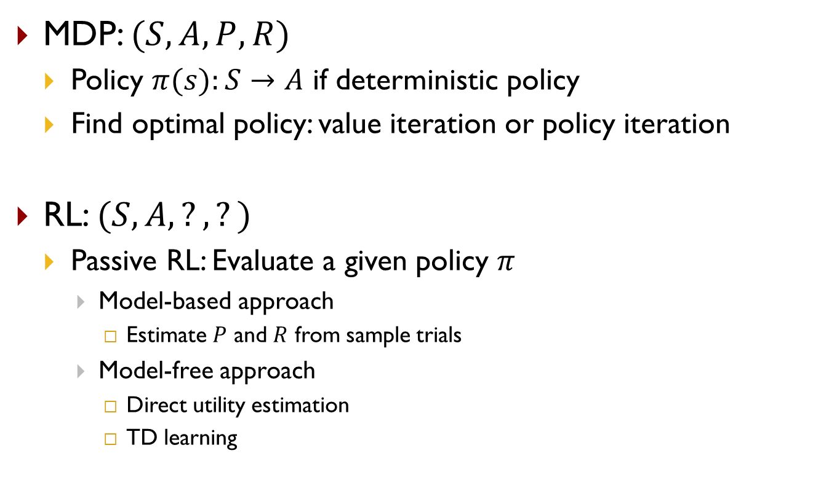
Recap
MDP: $(S,A,P,R)$
  Policy $π(s):S→A$ if deterministic policy
  Find optimal policy: value iteration or policy iteration
RL: $(S,A,?,?)$
  Passive RL: Evaluate a given policy $π$
    Model-based approach
      Estimate $P$ and $R$ from sample trials
    Model-free approach
      Direct utility estimation
      TD learning
Know exactly how the world works
Don’t know how the world works

Slide 3
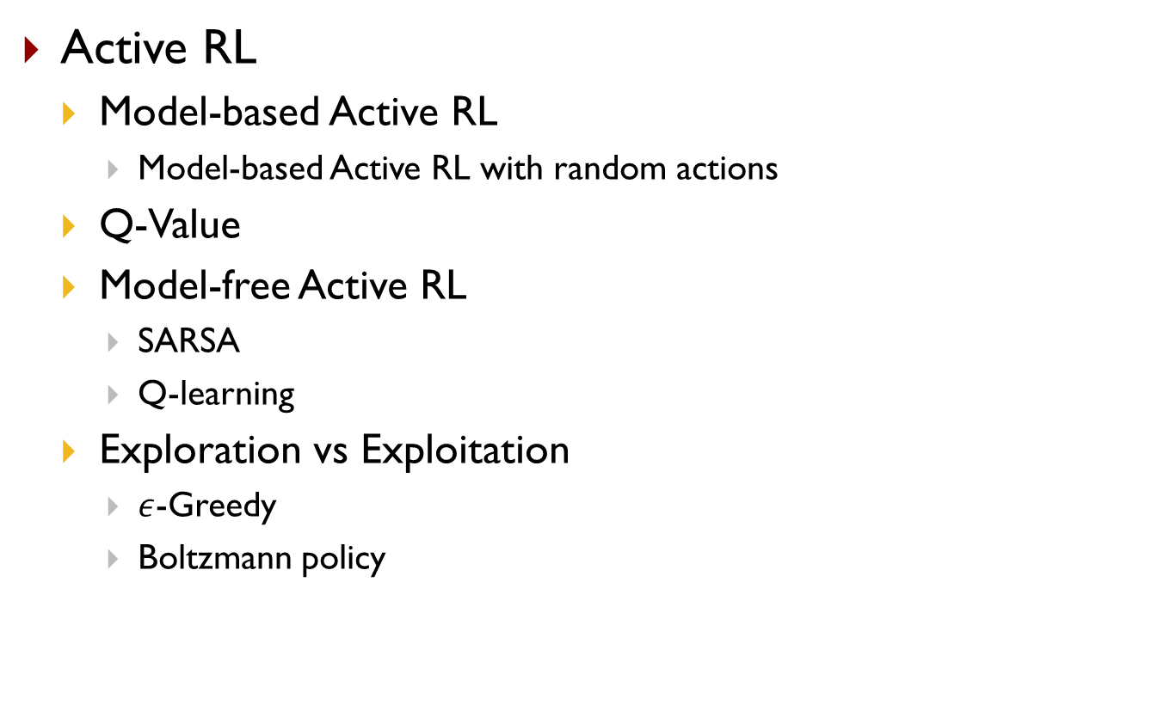
Outline
Active RL
  Model-based Active RL
    Model-based Active RL with random actions
  Q-Value
  Model-free Active RL
    SARSA
    Q-learning
  Exploration vs Exploitation
    $ε$-Greedy
    Boltzmann policy

Slide 4
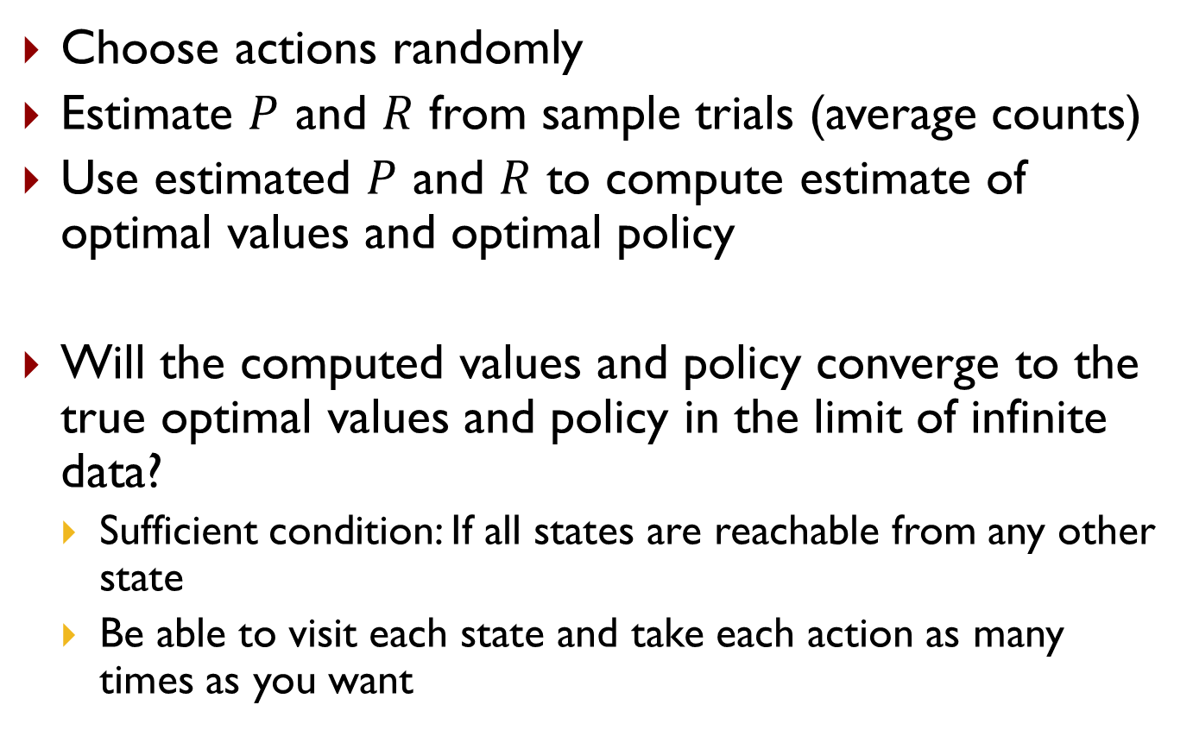
Model-Based Active RL with Random Actions
Choose actions randomly
Estimate $P$ and $R$ from sample trials (average counts)
Use estimated $P$ and $R$ to compute estimate of optimal values and optimal policy
Will the computed values and policy converge to the true optimal values and policy in the limit of infinite data?
  Sufficient condition: If all states are reachable from any other state
  Be able to visit each state and take each action as many times as you want

Slide 5
Outline
Active RL
  Model-based Active RL
    Model-based Active RL with random actions
  Q-Value
  Model-free Active RL
    SARSA
    Q-learning
  Exploration vs Exploitation
    $ε$-Greedy
    Boltzmann policy

Slide 6

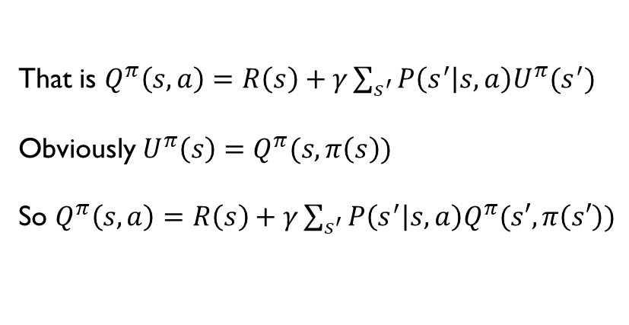
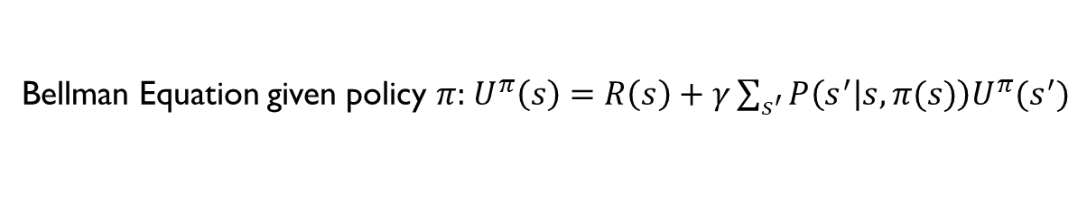
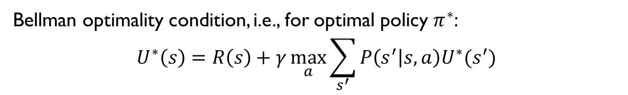
Q-Value
Recall
Q-value
  Similar to value function, but defined on state-action pair
  $Q^{π}(s,a)$: expected total reward from state $s$ onward if taking action $a$ in state $s$, and follow policy $π$ afterward
Bellman Equation given policy $π$: $U^{π}\left(s\right)=R\left(s\right)+γ\sum_{s^{′}}{P\left(s^{′} | s,π(s)\right)U^{π}(s^{′})}$
Bellman optimality condition, i.e., for optimal policy $π^{∗}$:
$$U^{∗}\left(s\right)=R\left(s\right)+γ\max_{a}{\sum_{s^{′}}{P\left(s^{′} | s,a\right)U^{∗}(s^{′})}}$$
That is $Q^{π}\left(s,a\right)=R\left(s\right)+γ\sum_{s^{′}}{P\left(s^{′} | s,a\right)U^{π}(s^{′})}$
Obviously $U^{π}\left(s\right)=Q^{π}(s,π\left(s\right))$
So $Q^{π}\left(s,a\right)=R\left(s\right)+γ\sum_{s^{′}}{P\left(s^{′} | s,a\right)Q^{π}(s′,π\left(s′\right))}$

Slide 7
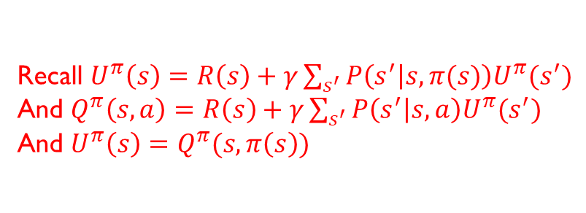
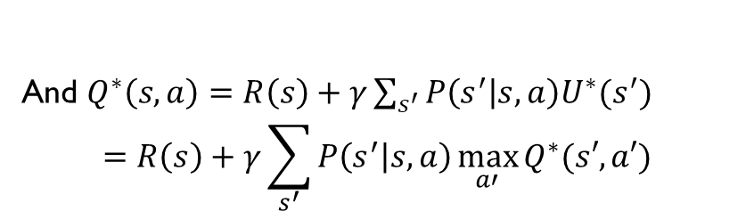


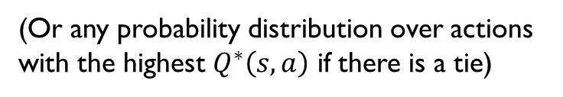

Optimal Q-Value
Recall $U^{π}\left(s\right)=R\left(s\right)+γ\sum_{s^{′}}{P\left(s^{′} | s,π(s)\right)U^{π}(s^{′})}$
And $Q^{π}\left(s,a\right)=R\left(s\right)+γ\sum_{s^{′}}{P\left(s^{′} | s,a\right)U^{π}(s^{′})}$
And $U^{π}\left(s\right)=Q^{π}(s,π\left(s\right))$
When using optimal policy $π^{∗}$, we will take the action that leads to maximum total utility at each state
Therefore
(Or any probability distribution over actions with the highest $Q^{∗}\left(s,a\right)$ if there is a tie)
$$π^{∗}\left(s\right)=\underset{a}{argmax}{Q^{∗}\left(s,a\right)}$$
We have $U^{∗}\left(s\right)=Q^{∗}\left(s,π^{∗}\left(s\right)\right)=\max_{a}{Q^{∗}(s,a)}$
And $Q^{∗}\left(s,a\right)=R\left(s\right)+γ\sum_{s^{′}}{P\left(s^{′} | s,a\right)U^{∗}(s^{′})}$
$$=R\left(s\right)+γ\sum_{s^{′}}{P\left(s^{′} | s,a\right)\max_{a′}{Q^{∗}(s′,a′)}}$$

Slide 8
Outline
Active RL
  Model-based Active RL
    Model-based Active RL with random actions
  Q-Value
  Model-free Active RL
    SARSA
    Q-learning
  Exploration vs Exploitation
    $ε$-Greedy
    Boltzmann policy

Slide 9

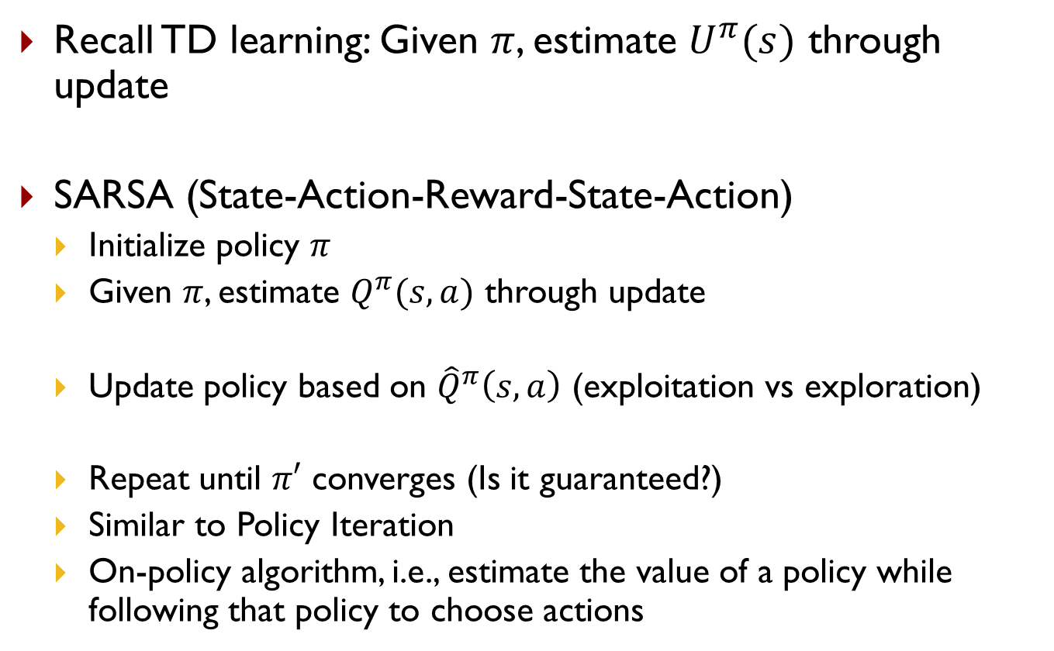

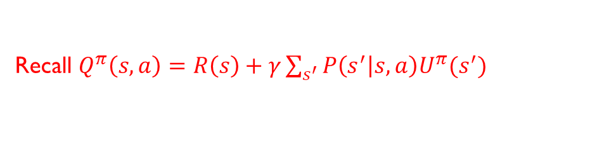
SARSA
Recall $Q^{π}\left(s,a\right)=R\left(s\right)+γ\sum_{s^{′}}{P\left(s^{′} | s,a\right)U^{π}(s^{′})}$
Recall TD learning: Given $π$, estimate $U^{π}(s)$ through update
SARSA (State-Action-Reward-State-Action)
  Initialize policy $π$
  Given $π$, estimate $Q^{π}(s,a)$ through update
  Update policy based on ${\hat{Q}}^{π}\left(s,a\right)$ (exploitation vs exploration)
  Repeat until $π′$ converges (Is it guaranteed?)
  Similar to Policy Iteration
  On-policy algorithm, i.e., estimate the value of a policy while following that policy to choose actions
$$\hat{U}\left(s\right)←\left(1−α\right)\hat{U}\left(s\right)+α(r+γ\hat{U}\left(s^{′}\right))$$
$${\hat{Q}}^{π}\left(s,a\right)←\left(1−α\right){\hat{Q}}^{π}\left(s,a\right)+α(r+γ{\hat{Q}}^{π}\left(s′,π(s^{′})\right))$$
(Full exploitation) $π^{′}\left(s\right)=\underset{a}{argmax}{{\hat{Q}}^{π}\left(s,a\right)}$

Slide 10
On-Policy vs Off-Policy Methods
Two types of RL approaches:
  On-policy methods attempt to evaluate or improve the policy that is used to make decisions
  Off-policy methods evaluate or improve a policy different from that used to generate the data

Slide 11
Outline
Active RL
  Model-based Active RL
    Model-based Active RL with random actions
  Q-Value
  Model-free Active RL
    SARSA
    Q-learning
  Exploration vs Exploitation
    $ε$-Greedy
    Boltzmann policy

Slide 12
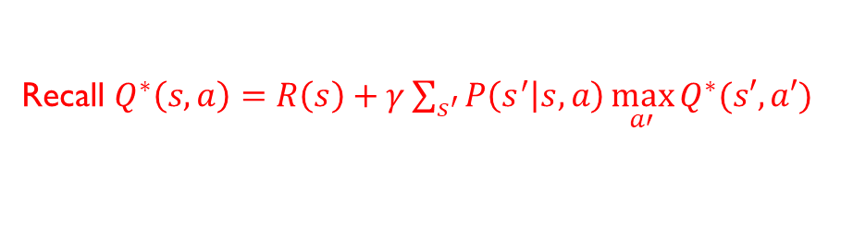
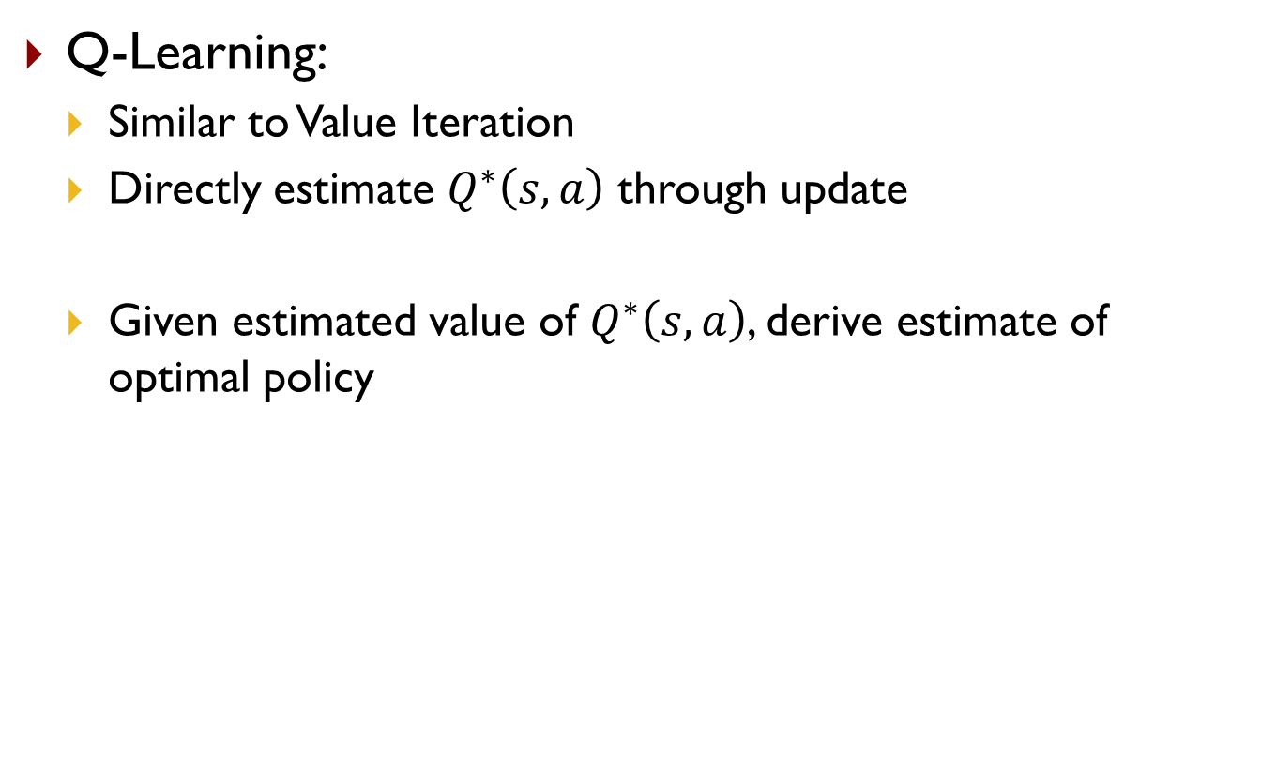

Q-Learning
Recall $Q^{∗}\left(s,a\right)=R\left(s\right)+γ\sum_{s^{′}}{P\left(s^{′} | s,a\right)\max_{a′}{Q^{∗}(s′,a′)}}$
Q-Learning:
  Similar to Value Iteration
  Directly estimate $Q^{∗}\left(s,a\right)$ through update
  Given estimated value of $Q^{∗}\left(s,a\right)$, derive estimate of optimal policy
$${\hat{Q}}^{∗}\left(s,a\right)←\left(1−α\right){\hat{Q}}^{∗}\left(s,a\right)+α(r+γ\max_{a′}{{\hat{Q}}^{∗}\left(s′,a′\right)})$$
$${\hat{π}}^{∗}\left(s\right)=\underset{a}{argmax}{{\hat{Q}}^{∗}\left(s,a\right)}$$

Slide 13
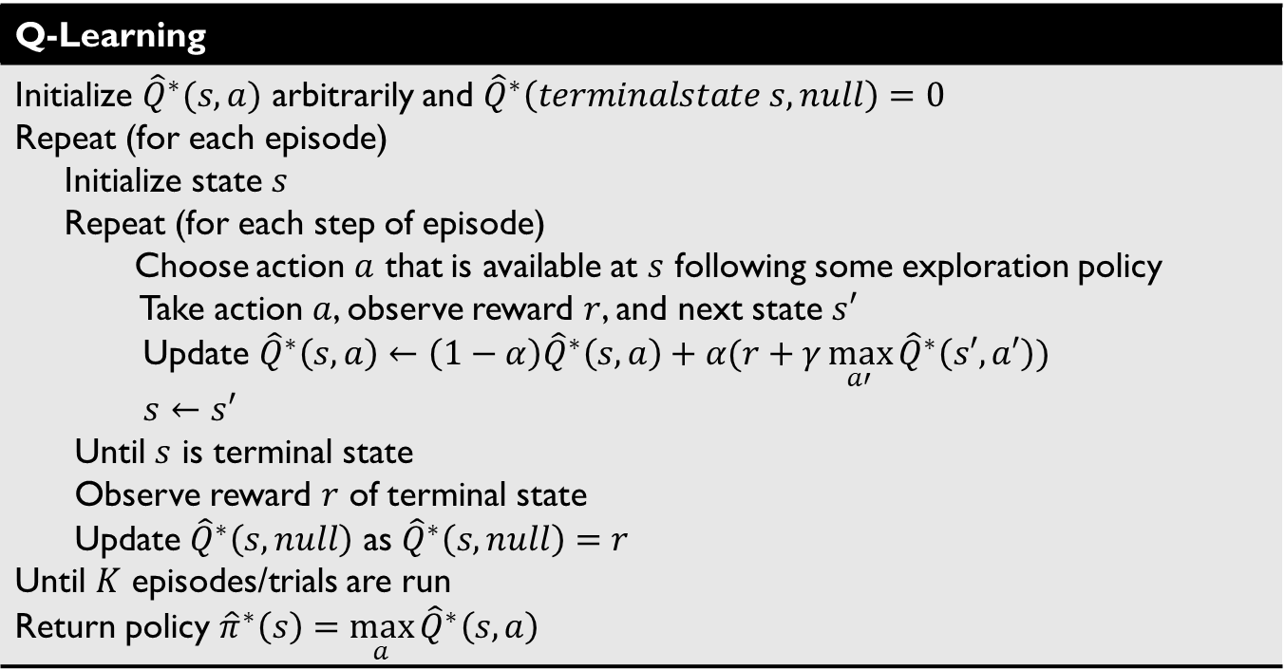
Q-Learning
Recall update ${\hat{Q}}^{∗}\left(s,a\right)←\left(1−α\right){\hat{Q}}^{∗}\left(s,a\right)+α(r+γ\max_{a′}{{\hat{Q}}^{∗}\left(s′,a′\right)})$
Q-Learning
Initialize ${\hat{Q}}^{∗}(s,a)$ arbitrarily and ${\hat{Q}}^{∗}\left(terminalstate s,null\right)=0$ Repeat (for each episode) Initialize state $s$ Repeat (for each step of episode) Choose action $a$ that is available at $s$ following some exploration policy Take action $a$, observe reward $r$, and next state $s′$ Update ${\hat{Q}}^{∗}\left(s,a\right)←\left(1−α\right){\hat{Q}}^{∗}\left(s,a\right)+α(r+γ\max_{a′}{{\hat{Q}}^{∗}\left(s′,a′\right)})$ $s←s′$ Until $s$ is terminal state Observe reward $r$ of terminal state Update ${\hat{Q}}^{∗}\left(s,null\right)$ as ${\hat{Q}}^{∗}\left(s,null\right)=r$ Until $K$ episodes/trials are run Return policy ${\hat{π}}^{∗}\left(s\right)=\max_{a}{{\hat{Q}}^{∗}\left(s,a\right)}$
Off policy algorithm: the policy is being evaluated (estimation policy) is unrelated to the policy being followed (behavior policy)

Slide 14

Q-Learning
Recall update ${\hat{Q}}^{∗}\left(s,a\right)←\left(1−α\right){\hat{Q}}^{∗}\left(s,a\right)+α(r+γ\max_{a′}{{\hat{Q}}^{∗}\left(s′,a′\right)})$
Q-Learning
Initialize ${\hat{Q}}^{∗}(s,a)$ arbitrarily and ${\hat{Q}}^{∗}\left(terminalstate s,null\right)=0$ Repeat (for each episode) Initialize state $s$ Repeat (for each step of episode) Choose action $a$ that is available at $s$ following some exploration policy Take action $a$, observe reward $r$, and next state $s′$ Update ${\hat{Q}}^{∗}\left(s,a\right)←\left(1−α\right){\hat{Q}}^{∗}\left(s,a\right)+α(r+γ\max_{a′}{{\hat{Q}}^{∗}\left(s′,a′\right)})$ $s←s′$ Until $s$ is terminal state Observe reward $r$ of terminal state Update ${\hat{Q}}^{∗}\left(s,null\right)$ as ${\hat{Q}}^{∗}\left(s,null\right)=r$ Until $K$ episodes/trials are run Return policy ${\hat{π}}^{∗}\left(s\right)=\max_{a}{{\hat{Q}}^{∗}\left(s,a\right)}$
(e.g., uniform random or $ε$-greedy)
Behavior policy
Update Q estimate with the sample data but according to a greedy policy for action selection (take the max) ≠ behavior policy
May use some other termination criteria
Off policy algorithm: the policy is being evaluated (estimation policy) is unrelated to the policy being followed (behavior policy)

Slide 15
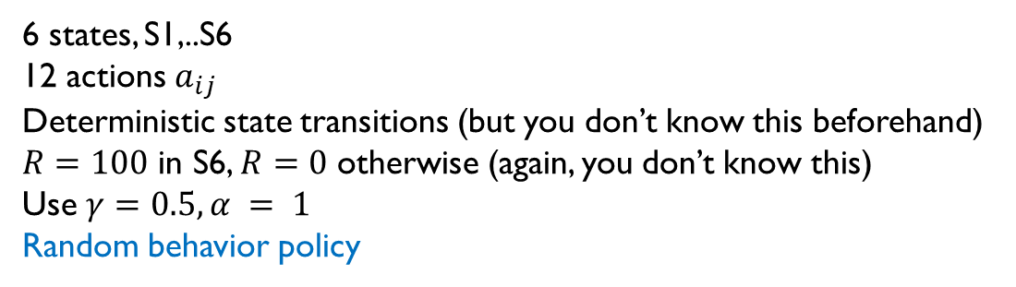
Q-Learning Example
a₁₂
a₂₃
S1 | S2 | S3
S4 | S5 | S6: END
a₁₄
a₂₁
a₂₅
a₃₂
a₃₆
a₄₁
a₅₂
a₄₅
a₅₆
a₅₄
6 states, S1,..S6
12 actions $a_{ij}$
Deterministic state transitions (but you don’t know this beforehand)
$R=100$ in S6, $R=0$ otherwise (again, you don’t know this)
Use $γ=0.5, α = 1$
Random behavior policy

Slide 16
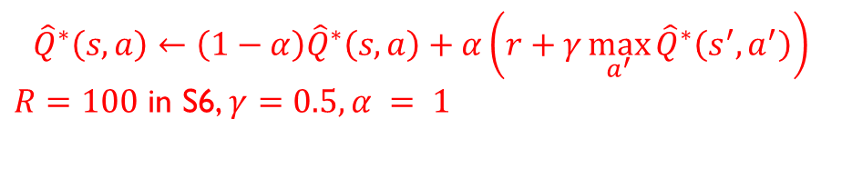
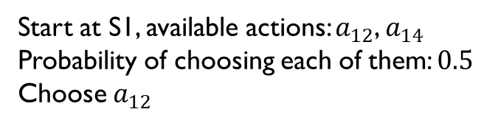
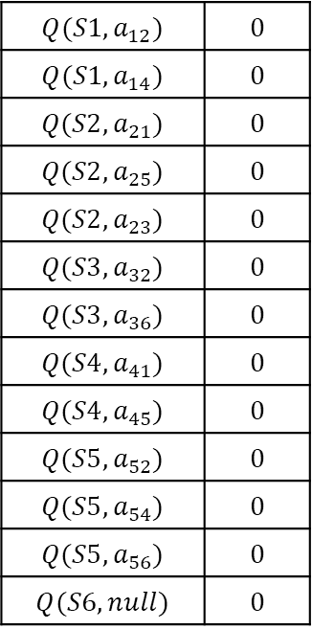
Q-Learning Example
$${\hat{Q}}^{∗}\left(s,a\right)←\left(1−α\right){\hat{Q}}^{∗}\left(s,a\right)+α\left(r+γ\max_{a^{′}}{{\hat{Q}}^{∗}\left(s^{′},a^{′}\right)}\right)$$
$R=100$ in S6, $γ=0.5, α = 1$
a₁₂
a₂₃
$$Q(S1,a_{12})$$ | $$0$$
$$Q(S1,a_{14})$$ | $$0$$
$$Q(S2,a_{21})$$ | $$0$$
$$Q(S2,a_{25})$$ | $$0$$
$$Q(S2,a_{23})$$ | $$0$$
$$Q(S3,a_{32})$$ | $$0$$
$$Q(S3,a_{36})$$ | $$0$$
$$Q(S4,a_{41})$$ | $$0$$
$$Q(S4,a_{45})$$ | $$0$$
$$Q(S5,a_{52})$$ | $$0$$
$$Q(S5,a_{54})$$ | $$0$$
$$Q(S5,a_{56})$$ | $$0$$
$$Q(S6,null)$$ | $$0$$
S1 | S2 | S3
S4 | S5 | S6: END
a₁₄
a₂₁
a₂₅
a₃₂
a₃₆
a₄₁
a₅₂
a₄₅
a₅₆
a₅₄
Start at S1, available actions: $a_{12}$, $a_{14}$
Probability of choosing each of them: $0.5$
Choose $a_{12}$
Get reward 0, get to state S2
Update state-value function
$${\hat{Q}}^{∗}\left(S1,a_{12}\right)←\left(1−α\right){\hat{Q}}^{∗}\left(S1,a_{12}\right)+α\left(r+γ\max_{a^{′}∈\left\{a_{21},a_{23},a_{25}\right\}}{{\hat{Q}}^{∗}\left(S2,a^{′}\right)}\right)=0$$

Slide 17
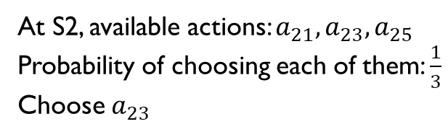
Q-Learning Example
$${\hat{Q}}^{∗}\left(s,a\right)←\left(1−α\right){\hat{Q}}^{∗}\left(s,a\right)+α\left(r+γ\max_{a^{′}}{{\hat{Q}}^{∗}\left(s^{′},a^{′}\right)}\right)$$
$R=100$ in S6, $γ=0.5, α = 1$
a₁₂
a₂₃
$$Q(S1,a_{12})$$ | $$0$$
$$Q(S1,a_{14})$$ | $$0$$
$$Q(S2,a_{21})$$ | $$0$$
$$Q(S2,a_{25})$$ | $$0$$
$$Q(S2,a_{23})$$ | $$0$$
$$Q(S3,a_{32})$$ | $$0$$
$$Q(S3,a_{36})$$ | $$0$$
$$Q(S4,a_{41})$$ | $$0$$
$$Q(S4,a_{45})$$ | $$0$$
$$Q(S5,a_{52})$$ | $$0$$
$$Q(S5,a_{54})$$ | $$0$$
$$Q(S5,a_{56})$$ | $$0$$
$$Q(S6,null)$$ | $$0$$
S1 | S2 | S3
S4 | S5 | S6: END
a₁₄
a₂₁
a₂₅
a₃₂
a₃₆
a₄₁
a₅₂
a₄₅
a₅₆
a₅₄
At S2, available actions: $a_{21},a_{23},a_{25}$
Probability of choosing each of them: $\frac{1}{3}$
Choose $a_{23}$
Get reward 0, get to state S3
Update state-value function
$${\hat{Q}}^{∗}\left(S2,a_{23}\right)←\left(1−α\right){\hat{Q}}^{∗}\left(S2,a_{23}\right)+α\left(r+γ\max_{a^{′}∈\left\{a_{32},a_{36}\right\}}{{\hat{Q}}^{∗}\left(S3,a^{′}\right)}\right)=0$$

Slide 18
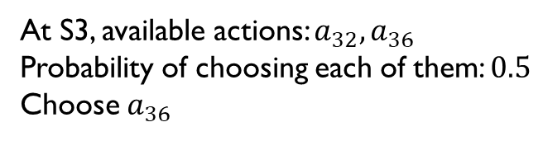
Q-Learning Example
$${\hat{Q}}^{∗}\left(s,a\right)←\left(1−α\right){\hat{Q}}^{∗}\left(s,a\right)+α\left(r+γ\max_{a^{′}}{{\hat{Q}}^{∗}\left(s^{′},a^{′}\right)}\right)$$
$R=100$ in S6, $γ=0.5, α = 1$
a₁₂
a₂₃
$$Q(S1,a_{12})$$ | $$0$$
$$Q(S1,a_{14})$$ | $$0$$
$$Q(S2,a_{21})$$ | $$0$$
$$Q(S2,a_{25})$$ | $$0$$
$$Q(S2,a_{23})$$ | $$0$$
$$Q(S3,a_{32})$$ | $$0$$
$$Q(S3,a_{36})$$ | $$0$$
$$Q(S4,a_{41})$$ | $$0$$
$$Q(S4,a_{45})$$ | $$0$$
$$Q(S5,a_{52})$$ | $$0$$
$$Q(S5,a_{54})$$ | $$0$$
$$Q(S5,a_{56})$$ | $$0$$
$$Q(S6,null)$$ | $$0$$
S1 | S2 | S3
S4 | S5 | S6: END
a₁₄
a₂₁
a₂₅
a₃₂
a₃₆
a₄₁
a₅₂
a₄₅
a₅₆
a₅₄
At S3, available actions: $a_{32},a_{36}$
Probability of choosing each of them: $0.5$
Choose $a_{36}$
Get reward 0, get to state S6
Update state-value function
$${\hat{Q}}^{∗}\left(S3,a_{36}\right)←\left(1−α\right){\hat{Q}}^{∗}\left(S3,a_{36}\right)+α\left(r+γ\max_{a^{′}∈\left\{null\right\}}{{\hat{Q}}^{∗}\left(S6,a^{′}\right)}\right)=0$$

Slide 19
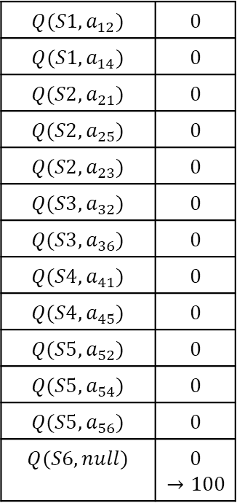
Q-Learning Example
$${\hat{Q}}^{∗}\left(s,a\right)←\left(1−α\right){\hat{Q}}^{∗}\left(s,a\right)+α\left(r+γ\max_{a^{′}}{{\hat{Q}}^{∗}\left(s^{′},a^{′}\right)}\right)$$
$R=100$ in S6, $γ=0.5, α = 1$
a₁₂
a₂₃
$$Q(S1,a_{12})$$ | $$0$$
$$Q(S1,a_{14})$$ | $$0$$
$$Q(S2,a_{21})$$ | $$0$$
$$Q(S2,a_{25})$$ | $$0$$
$$Q(S2,a_{23})$$ | $$0$$
$$Q(S3,a_{32})$$ | $$0$$
$$Q(S3,a_{36})$$ | $$0$$
$$Q(S4,a_{41})$$ | $$0$$
$$Q(S4,a_{45})$$ | $$0$$
$$Q(S5,a_{52})$$ | $$0$$
$$Q(S5,a_{54})$$ | $$0$$
$$Q(S5,a_{56})$$ | $$0$$
$$Q(S6,null)$$ | $$0$$ $$→100$$
S1 | S2 | S3
S4 | S5 | S6: END
a₁₄
a₂₁
a₂₅
a₃₂
a₃₆
a₄₁
a₅₂
a₄₅
a₅₆
a₅₄
Terminal state, get reward 100, ${\hat{Q}}^{∗}\left(S6,null\right)←100$

Slide 20
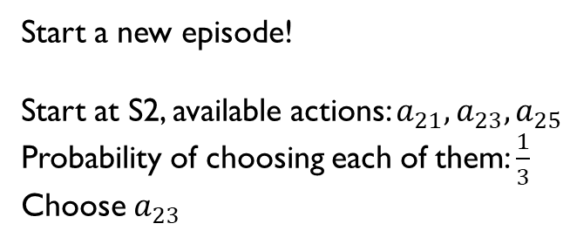
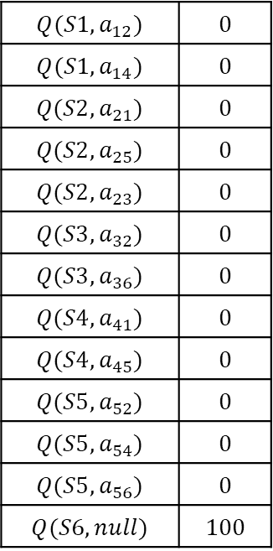
Q-Learning Example
$${\hat{Q}}^{∗}\left(s,a\right)←\left(1−α\right){\hat{Q}}^{∗}\left(s,a\right)+α\left(r+γ\max_{a^{′}}{{\hat{Q}}^{∗}\left(s^{′},a^{′}\right)}\right)$$
$R=100$ in S6, $γ=0.5, α = 1$
a₁₂
a₂₃
$$Q(S1,a_{12})$$ | $$0$$
$$Q(S1,a_{14})$$ | $$0$$
$$Q(S2,a_{21})$$ | $$0$$
$$Q(S2,a_{25})$$ | $$0$$
$$Q(S2,a_{23})$$ | $$0$$
$$Q(S3,a_{32})$$ | $$0$$
$$Q(S3,a_{36})$$ | $$0$$
$$Q(S4,a_{41})$$ | $$0$$
$$Q(S4,a_{45})$$ | $$0$$
$$Q(S5,a_{52})$$ | $$0$$
$$Q(S5,a_{54})$$ | $$0$$
$$Q(S5,a_{56})$$ | $$0$$
$$Q(S6,null)$$ | $$100$$
S1 | S2 | S3
S4 | S5 | S6: END
a₁₄
a₂₁
a₂₅
a₃₂
a₃₆
a₄₁
a₅₂
a₄₅
a₅₆
a₅₄
Start a new episode!
Start at S2, available actions: $a_{21},a_{23},a_{25}$
Probability of choosing each of them: $\frac{1}{3}$
Choose $a_{23}$
Get reward 0, get to state S3
Update state-value function
$${\hat{Q}}^{∗}\left(S2,a_{23}\right)←\left(1−α\right){\hat{Q}}^{∗}\left(S2,a_{23}\right)+α\left(r+γ\max_{a^{′}∈\left\{a_{32},a_{36}\right\}}{{\hat{Q}}^{∗}\left(S3,a^{′}\right)}\right)=0$$

Slide 21
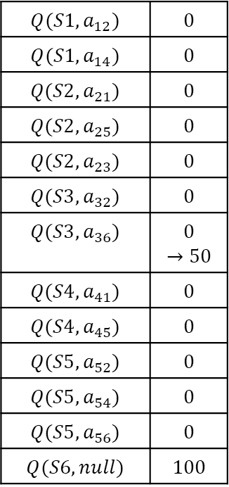
Q-Learning Example
$${\hat{Q}}^{∗}\left(s,a\right)←\left(1−α\right){\hat{Q}}^{∗}\left(s,a\right)+α\left(r+γ\max_{a^{′}}{{\hat{Q}}^{∗}\left(s^{′},a^{′}\right)}\right)$$
$R=100$ in S6, $γ=0.5, α = 1$
a₁₂
a₂₃
$$Q(S1,a_{12})$$ | $$0$$
$$Q(S1,a_{14})$$ | $$0$$
$$Q(S2,a_{21})$$ | $$0$$
$$Q(S2,a_{25})$$ | $$0$$
$$Q(S2,a_{23})$$ | $$0$$
$$Q(S3,a_{32})$$ | $$0$$
$$Q(S3,a_{36})$$ | $$0$$ $$→50$$
$$Q(S4,a_{41})$$ | $$0$$
$$Q(S4,a_{45})$$ | $$0$$
$$Q(S5,a_{52})$$ | $$0$$
$$Q(S5,a_{54})$$ | $$0$$
$$Q(S5,a_{56})$$ | $$0$$
$$Q(S6,null)$$ | $$100$$
S1 | S2 | S3
S4 | S5 | S6: END
a₁₄
a₂₁
a₂₅
a₃₂
a₃₆
a₄₁
a₅₂
a₄₅
a₅₆
a₅₄
At S3, available actions: $a_{32},a_{36}$
Probability of choosing each of them: $0.5$
Choose $a_{36}$
Get reward 0, get to state S6
Update state-value function
$${\hat{Q}}^{∗}\left(S3,a_{36}\right)←\left(1−α\right){\hat{Q}}^{∗}\left(S3,a_{36}\right)+α\left(r+γ\max_{a^{′}∈\left\{null\right\}}{{\hat{Q}}^{∗}\left(S6,a^{′}\right)}\right)=50$$

Slide 22
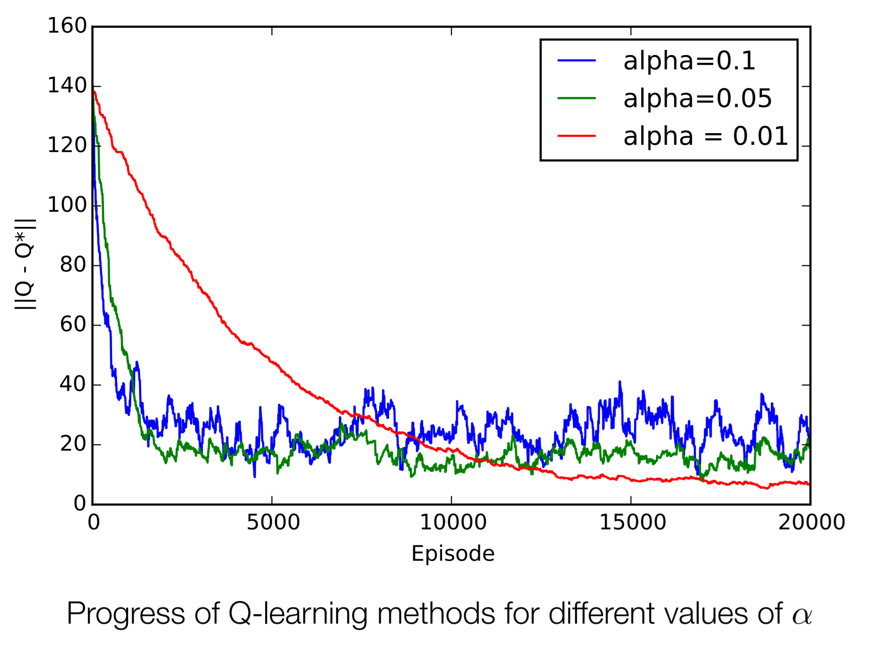
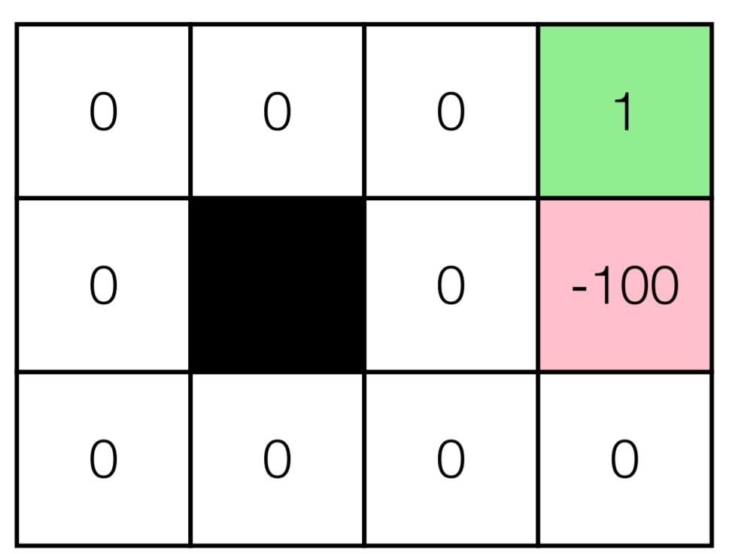

Q-Learning
Impact of $α$
Implication: Let $α$ decrease over time

Slide 23
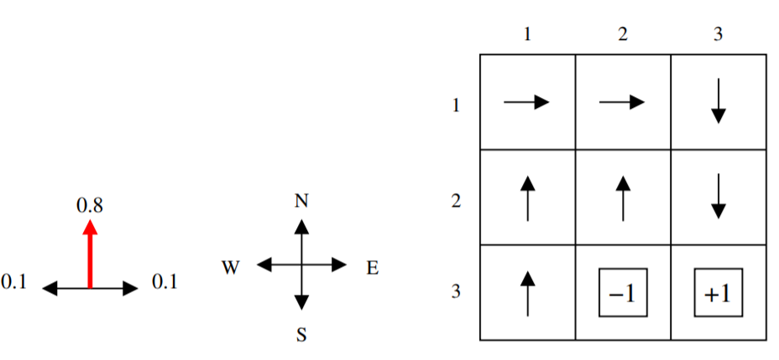


Q-Learning Example
Grid world example
$R\left(s\right)=0$ for non-terminal states, $γ=0.9$, $α\left(N\left(s\right)\right)=1/N(s)$
$${\hat{Q}}^{∗}\left(s,a\right)←\left(1−α(N\left(s\right))\right){\hat{Q}}^{∗}\left(s,a\right)+α(N\left(s\right))(r+γ\max_{a′}{{\hat{Q}}^{∗}\left(s′,a′\right)})$$
Update counter $N(s)$ before computing $α$

Slide 24
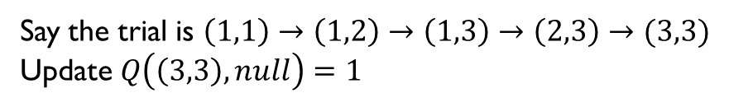

Q-Learning Example
Recall update ${\hat{Q}}^{∗}\left(s,a\right)←\left(1−α(N\left(s\right))\right){\hat{Q}}^{∗}\left(s,a\right)+α(N\left(s\right))(r+γ\max_{a′}{{\hat{Q}}^{∗}\left(s′,a′\right)})$
Start with Q-value being 0
Following uniform random strategy to select actions
Trial 1: No meaningful update until reaching a terminal state since reward is $0$ for non-terminal state
Say the trial is $\left(1,1\right)→\left(1,2\right)→\left(1,3\right)→\left(2,3\right)→(3,3)$
Update $Q\left(\left(3,3\right),null\right)=1$

Slide 25
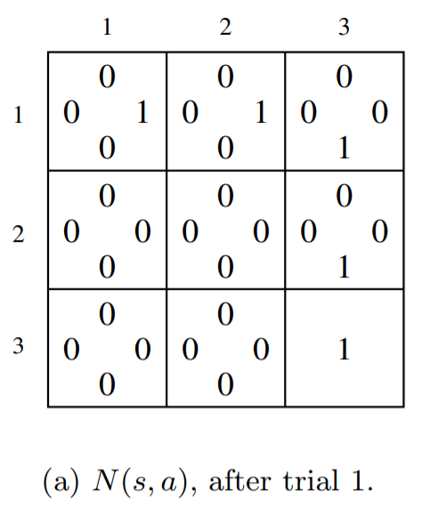
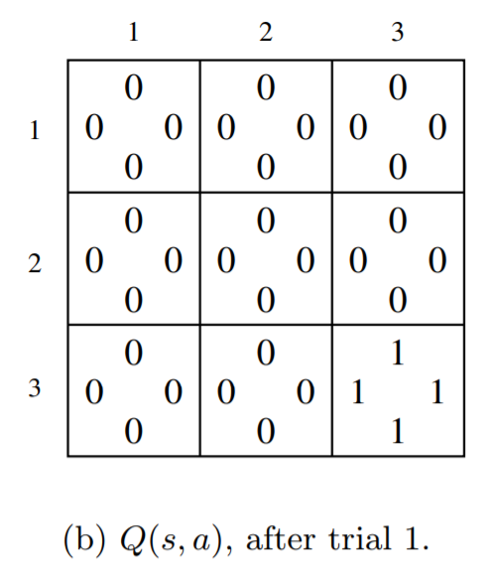
Q-Learning Example
Recall update ${\hat{Q}}^{∗}\left(s,a\right)←\left(1−α(N\left(s\right))\right){\hat{Q}}^{∗}\left(s,a\right)+α(N\left(s\right))(r+γ\max_{a′}{{\hat{Q}}^{∗}\left(s′,a′\right)})$
After trial 1:

Slide 26
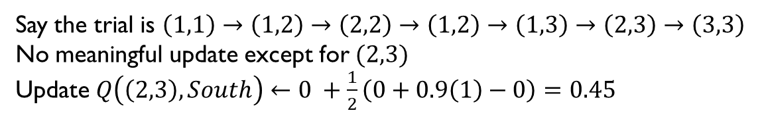
Q-Learning Example
Recall update ${\hat{Q}}^{∗}\left(s,a\right)←\left(1−α(N\left(s\right))\right){\hat{Q}}^{∗}\left(s,a\right)+α(N\left(s\right))(r+γ\max_{a′}{{\hat{Q}}^{∗}\left(s′,a′\right)})$
Trial 2:
Say the trial is $\left(1,1\right)→\left(1,2\right)→\left(2,2\right)→\left(1,2\right)→\left(1,3\right)→\left(2,3\right)→\left(3,3\right)$
No meaningful update except for $(2,3)$
Update $Q\left(\left(2,3\right),South\right)←0 +\frac{1}{2}\left(0+0.9\left(1\right)−0\right)=0.45$

Slide 27
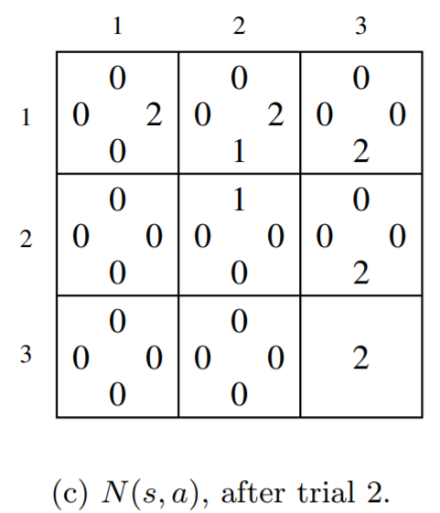
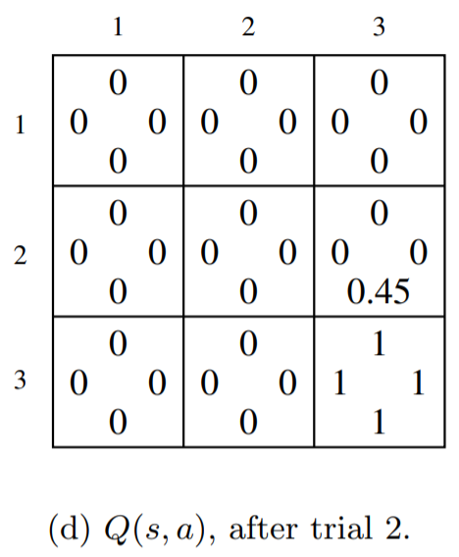
Q-Learning Example
Recall update ${\hat{Q}}^{∗}\left(s,a\right)←\left(1−α(N\left(s\right))\right){\hat{Q}}^{∗}\left(s,a\right)+α(N\left(s\right))(r+γ\max_{a′}{{\hat{Q}}^{∗}\left(s′,a′\right)})$
After trial 2:

Slide 28
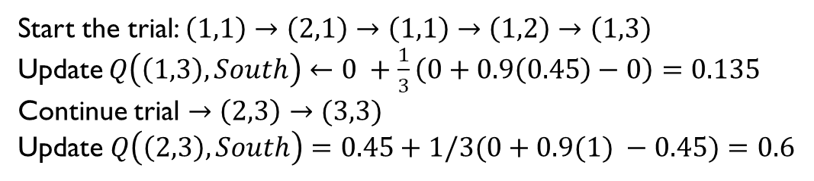
Q-Learning Example
Recall update ${\hat{Q}}^{∗}\left(s,a\right)←\left(1−α(N\left(s\right))\right){\hat{Q}}^{∗}\left(s,a\right)+α(N\left(s\right))(r+γ\max_{a′}{{\hat{Q}}^{∗}\left(s′,a′\right)})$
Trial 3:
Start the trial: $\left(1,1\right)→\left(2,1\right)→\left(1,1\right)→\left(1,2\right)→\left(1,3\right)$
Update $Q\left(\left(1,3\right),South\right)←0 +\frac{1}{3}\left(0+0.9\left(0.45\right)−0\right)=0.135$
Continue trial $→\left(2,3\right)→(3,3)$
Update $Q\left(\left(2,3\right),South\right)=0.45+1/3(0+0.9(1) −0.45)=0.6$

Slide 29
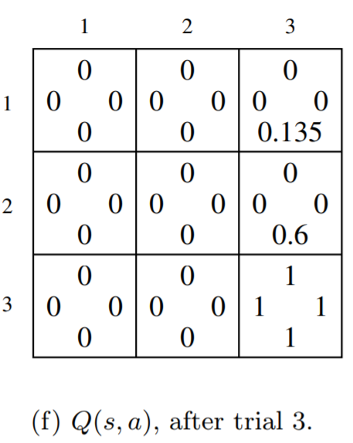
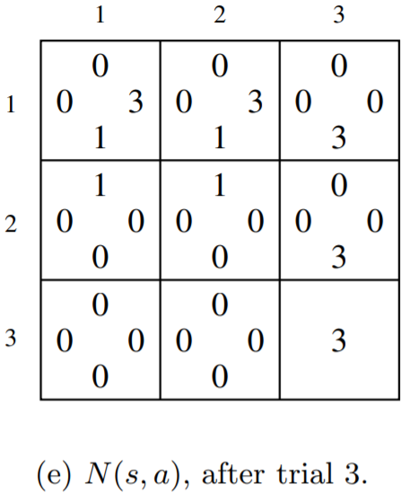
Q-Learning Example
Recall update ${\hat{Q}}^{∗}\left(s,a\right)←\left(1−α(N\left(s\right))\right){\hat{Q}}^{∗}\left(s,a\right)+α(N\left(s\right))(r+γ\max_{a′}{{\hat{Q}}^{∗}\left(s′,a′\right)})$
After trial 3:

Slide 30
Q-Learning Properties
If acting randomly, Q-learning converges to optimal state-action values, and also therefore finds optimal policy
  Off-policy learning
  Can act in one way
  But learning values of another policy (the optimal one!)
Acting randomly is sufficient, but not necessary, to learn the optimal values and policy

Slide 31
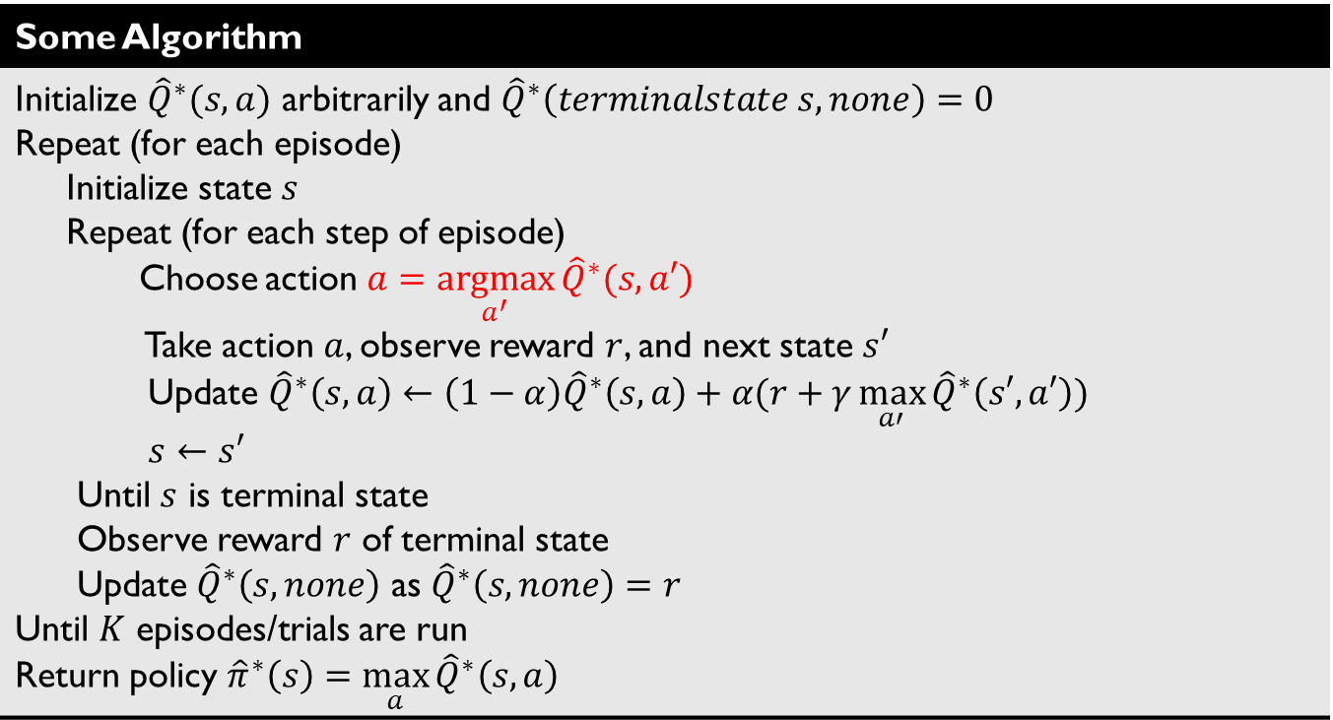
Quiz 1
Is the following algorithm guaranteed to learn optimal policy? A: Yes B: No C: Not sure
Some Algorithm
Initialize ${\hat{Q}}^{∗}(s,a)$ arbitrarily and ${\hat{Q}}^{∗}\left(terminalstate s,none\right)=0$ Repeat (for each episode) Initialize state $s$ Repeat (for each step of episode) Choose action $a=\underset{a^{′}}{argmax}{{\hat{Q}}^{∗}(s,a′)}$ Take action $a$, observe reward $r$, and next state $s′$ Update ${\hat{Q}}^{∗}\left(s,a\right)←\left(1−α\right){\hat{Q}}^{∗}\left(s,a\right)+α(r+γ\max_{a′}{{\hat{Q}}^{∗}\left(s′,a′\right)})$ $s←s′$ Until $s$ is terminal state Observe reward $r$ of terminal state Update ${\hat{Q}}^{∗}\left(s,none\right)$ as ${\hat{Q}}^{∗}\left(s,none\right)=r$ Until $K$ episodes/trials are run Return policy ${\hat{π}}^{∗}\left(s\right)=\max_{a}{{\hat{Q}}^{∗}\left(s,a\right)}$

Slide 32
Quiz 1
Is the following algorithm guaranteed to learn optimal policy? A: Yes B: No C: Not sure
Some Algorithm
Initialize ${\hat{Q}}^{∗}(s,a)$ arbitrarily and ${\hat{Q}}^{∗}\left(terminalstate s,none\right)=0$ Repeat (for each episode) Initialize state $s$ Repeat (for each step of episode) Choose action $a=\underset{a^{′}}{argmax}{{\hat{Q}}^{∗}(s,a′)}$ Take action $a$, observe reward $r$, and next state $s′$ Update ${\hat{Q}}^{∗}\left(s,a\right)←\left(1−α\right){\hat{Q}}^{∗}\left(s,a\right)+α(r+γ\max_{a′}{{\hat{Q}}^{∗}\left(s′,a′\right)})$ $s←s′$ Until $s$ is terminal state Observe reward $r$ of terminal state Update ${\hat{Q}}^{∗}\left(s,none\right)$ as ${\hat{Q}}^{∗}\left(s,none\right)=r$ Until $K$ episodes/trials are run Return policy ${\hat{π}}^{∗}\left(s\right)=\max_{a}{{\hat{Q}}^{∗}\left(s,a\right)}$
bad initial estimates in the first few cases can drive policy into sub-optimal region, and never explore further

Slide 33
Outline
Active RL
  Model-based Active RL
    Model-based Active RL with random actions
  Q-Value
  Model-free Active RL
    SARSA
    Q-learning
  Exploration vs Exploitation
    $ε$-Greedy
    Boltzmann policy

Slide 34
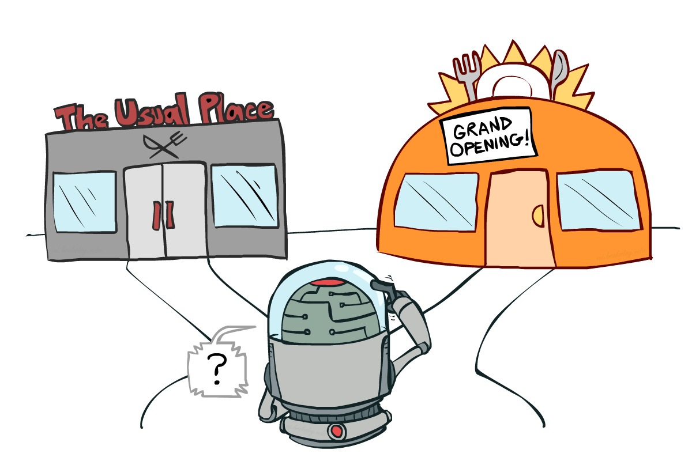
Exploration vs Exploitation

Slide 35
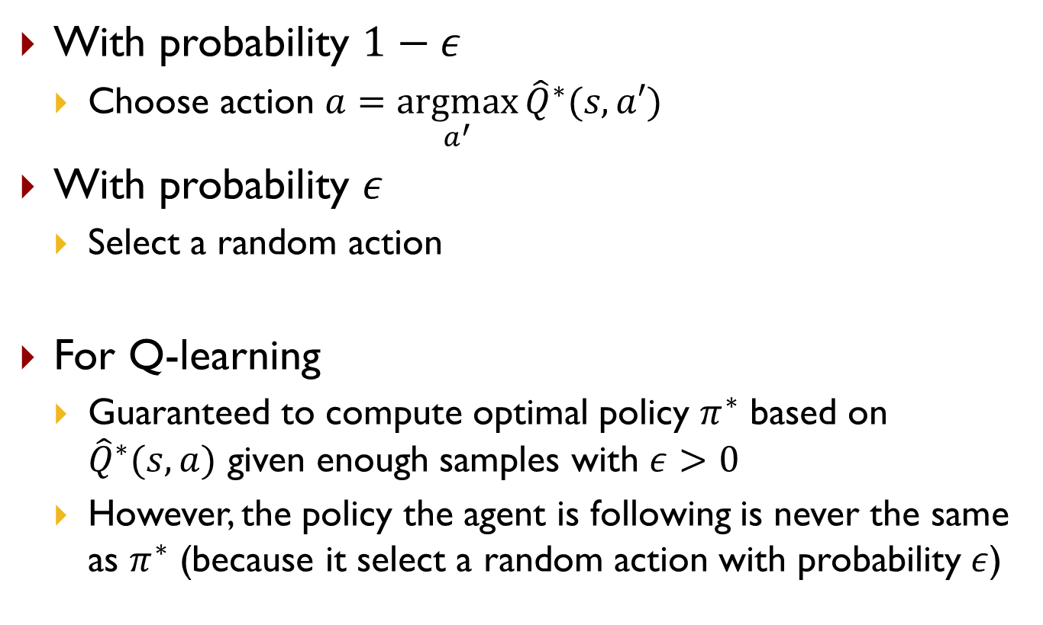

Simple Approach: $ε$-Greedy
With probability $1−ε$
  Choose action $a=\underset{a^{′}}{argmax}{{\hat{Q}}^{∗}(s,a′)}$
With probability $ε$
  Select a random action
For Q-learning
  Guaranteed to compute optimal policy $π^{∗}$ based on ${\hat{Q}}^{∗}(s,a)$ given enough samples with $ε>0$
  However, the policy the agent is following is never the same as $π^{∗}$ (because it select a random action with probability $ε$)

Slide 36
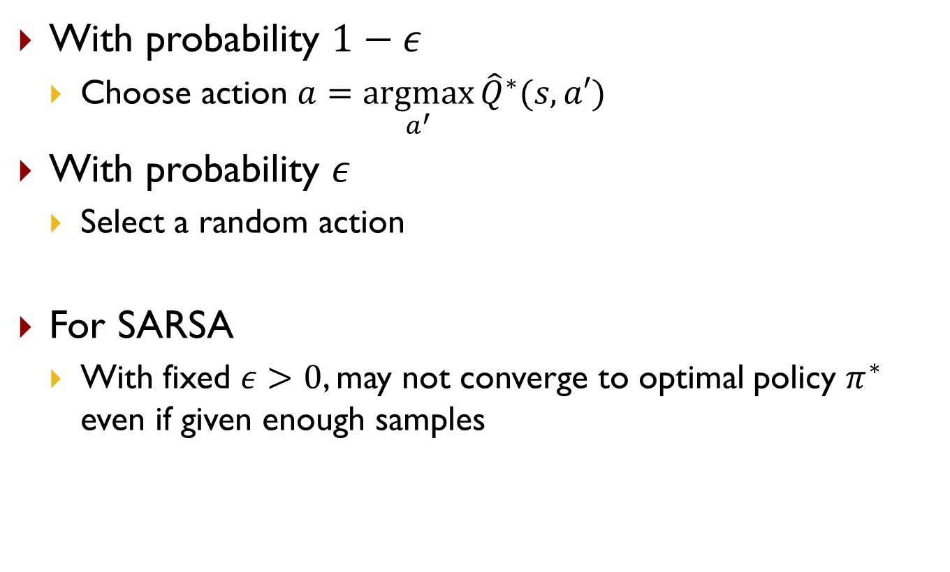
Simple Approach: $ε$-Greedy
With probability $1−ε$
  Choose action $a=\underset{a^{′}}{argmax}{{\hat{Q}}^{∗}(s,a′)}$
With probability $ε$
  Select a random action
For SARSA
  With fixed $ε>0$, may not converge to optimal policy $π^{∗}$ even if given enough samples

Slide 37
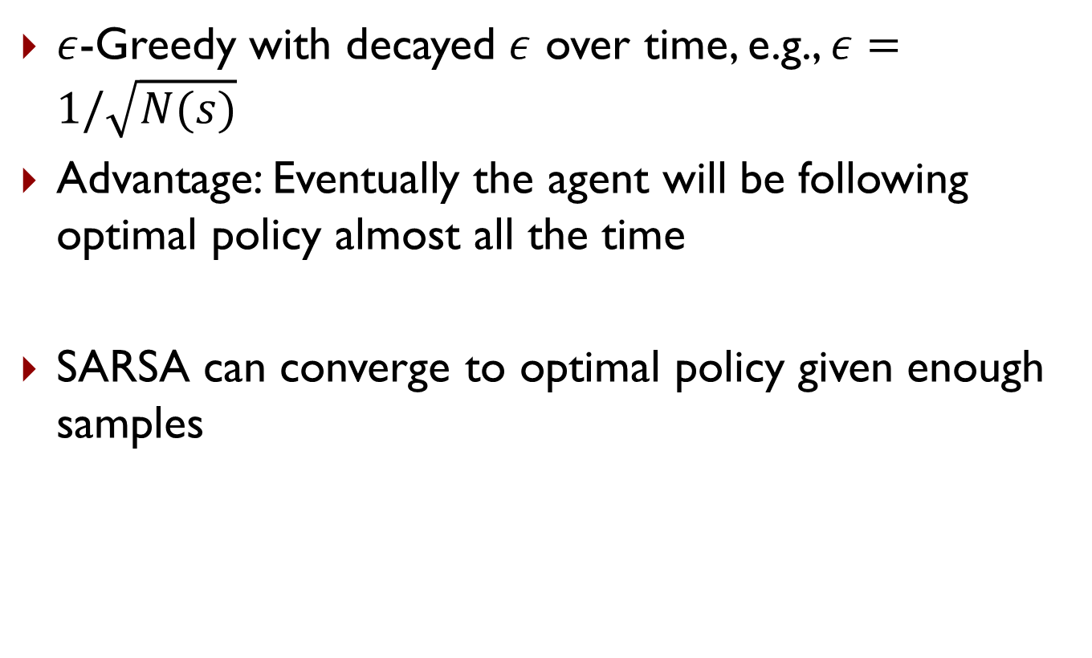
Greedy in Limit of Infinite Exploration (GLIE)
$ε$-Greedy with decayed $ε$ over time, e.g., $ε=1/\sqrt{N(s)}$
Advantage: Eventually the agent will be following optimal policy almost all the time
SARSA can converge to optimal policy given enough samples

Slide 38
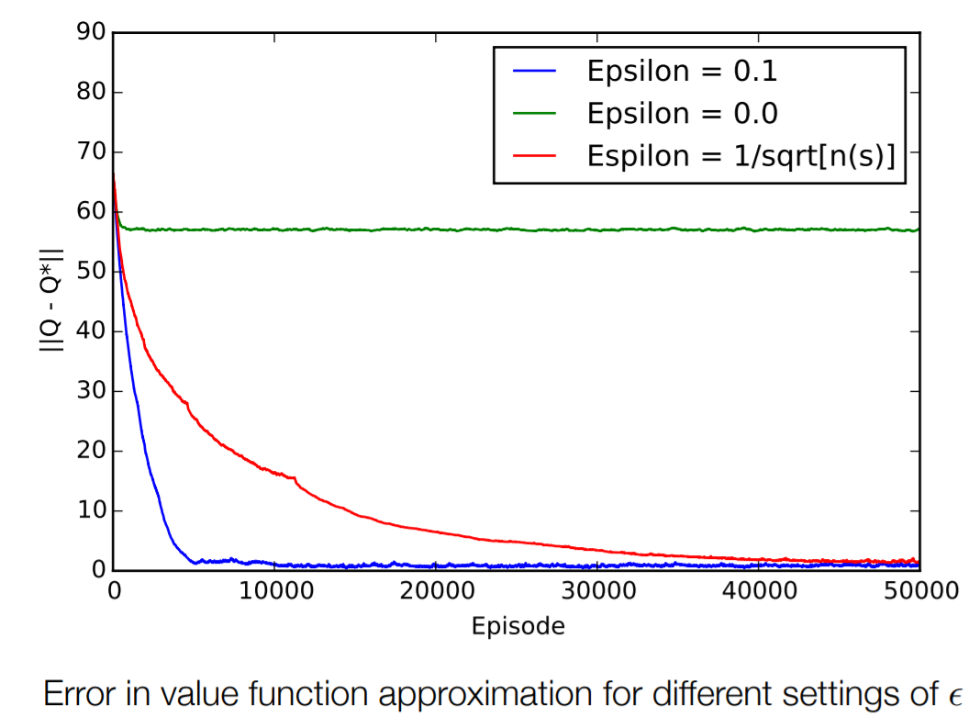
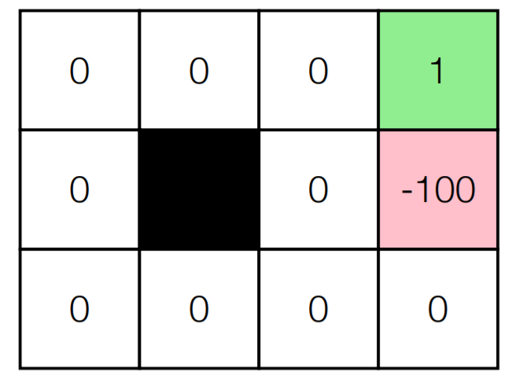


Impact of $ε$
Random terminal state utility sampled from $[0,1]$

Slide 39

Impact of $ε$

Slide 40


Boltzmann Policy
Choose action $a$ with probability $P(a|s)$

Slide 41

Quiz 2
If we want that eventually the agent will be following optimal policy almost all the time when using Boltzmann policy to sample actions, how should the value of $τ$ change as the learning progresses?
  A: Increase
  B: Decrease
  C: No change

Slide 42


Summary
Reinforcement Learning (RL)
Active RL
Model-free Active RL
Model-based Active RL
SARSA, Q-Learning (with some exploratory policy)
Estimate $P$ and $R$ through sampling

Slide 43
SARSA vs Q-Learning
SARSA | Q-Learning

Slide 44

SARSA vs Q-Learning
SARSA | Q-Learning
On-policy Need to iterate between computing policy and evaluating policy Cannot converge to optimal policy when using $ε$-Greedy with fixed $ε$ More realistic if the overall policy is even partly controlled by other agents | Off-policy Directly compute optimal $Q$ value, from which optimal policy can be derived Can learn how to behave well (converge to optimal policy) even when guided by a random or adversarial exploration policy (e.g., $ε$-Greedy)

Slide 45
Acknowledgment
Some slides are borrowed from previous slides made by Tai Sing Lee and Zico Kolter, and some examples are borrowed from Meg Aycinena and Emma Brunskill

Slide 46
Other Resources
http://courses.csail.mit.edu/6.825/fall05/rl_lecture/rl_examples.pdf
http://www.cs.cmu.edu/afs/cs/academic/class/15780-s16/www/slides/rl.pdf
http://incompleteideas.net/book/bookdraft2017nov5.pdf

Slide 47
Backup Slides

Slide 48

Terminal States and Reward
What is terminal state and when do agent get reward
  You will see different formulations and different definitions of terminal state and reward
  In some formulation, a terminal state cannot have a reward
  In some formulation, a terminal state have a reward
  In some formulations, agent get the reward $R(s)$ every time it take an action from state $s$
  In some formulations, agent get the reward $R(s′)$ every time it take an action from state $s$, and end up at state $s′$

Slide 49

Terminal States and Reward
In this lecture, we use the following formulation or interpretation
  Each state has a reward $R(s)$ or $R(s,a)$ or $R(s,a,s^{′})$, including the terminal state. For a terminal state $s$, the only available action is “null”, and the $s′$ can only be “null” (or “exited”)
  If at time $t$, the agent is at state $s$ and takes action $a$, and observes that it ends up at state $s′$, and gets a reward of $R(s)$ or $R(s,a)$ or $R(s,a,s^{′})$. Then time counter increments by 1, i.e., now it is time $t+1$, the agent can now take an action starting from state $s′$
  Why matter? For example, in Q-learning, you need to set Q value of a terminal state $s$ to be the reward you observe when you take the “null” action
When you read other books / exercise questions, pay attention to what their formulation is

Slide 50

Terminal States and Reward
How to reduce a game in our formulation to other alternative formulations?
  We call the original game in this formulation game $G$, with reward function $R$, and we will create a new game $\tilde{G}$ in the alternative formulation, with reward function $\tilde{R}$

Slide 51

Terminal States and Reward
How to reduce a game in our formulation to other alternative formulations?
  (A terminal state cannot have a reward)
    Option 1: Create a new game $\tilde{G}$, which has a new absorb state $\tilde{s}$, all terminal states in the original game is linked to this absorb state through action “null”, and only the absorb state is the terminal state, and it has reward 0
      Why matter? For example, in Q-learning for game $\tilde{G}$, you need to set Q value of a terminal state $s$ (which is the absorb state) to be 0 before you do any Q-value update, and never update the Q-value for the terminal state

Slide 52

Terminal States and Reward
How to reduce a game in our formulation to other alternative formulations?
  (A terminal state cannot have a reward)
    Option 2: Create a new game $\tilde{G}$, and the reward function is in the form $\tilde{R}(s,a,s^{′})$. When the agent take an action $a$ from state $s$, which reaches terminal state $s′$, the reward is $\tilde{R}\left(s,a,s^{′}\right)=R\left(s\right)+R(s^{′})$

Slide 53

Terminal States and Reward
How to reduce a game in our formulation to other alternative formulations?
  (agent get the reward $R(s′)$ every time it take an action from state $s$, and end up at state $s′$)
    Create a new game $\tilde{G}$, which has a new starting state $\tilde{s}$, it is linked to all possible starting states through action “null”, with uniform random transition probability
    Why matter? For example, in Q-learning for game $\tilde{G}$, you need to set Q value of a terminal state $s$ to be 0 before you do any Q-value update, and never update the Q-value for the terminal state

